Slide 1
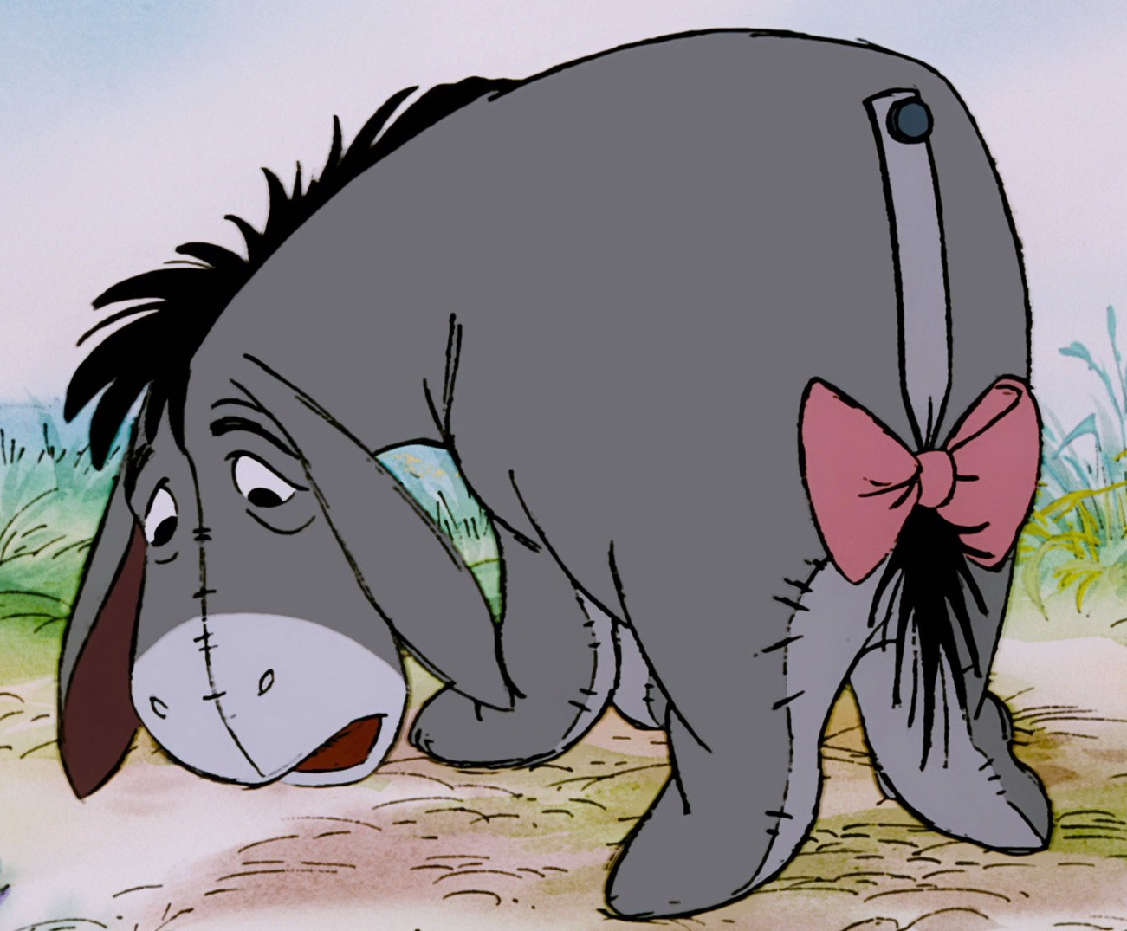
Isolation and loneliness in the COVID era among older adults
Chris Cunnigham
Citinomics
Solveig A Cunningham
Emory University, United States
Netherlands Interdisciplinary Demographic Institute, Netherlands
Audrey Ling
Emory University, United States
Jo Mhairi Hale
University of St Andrews, Scotland
Max Planck Institute for Demographic Research, Germany
citinomics.com

Slide 2
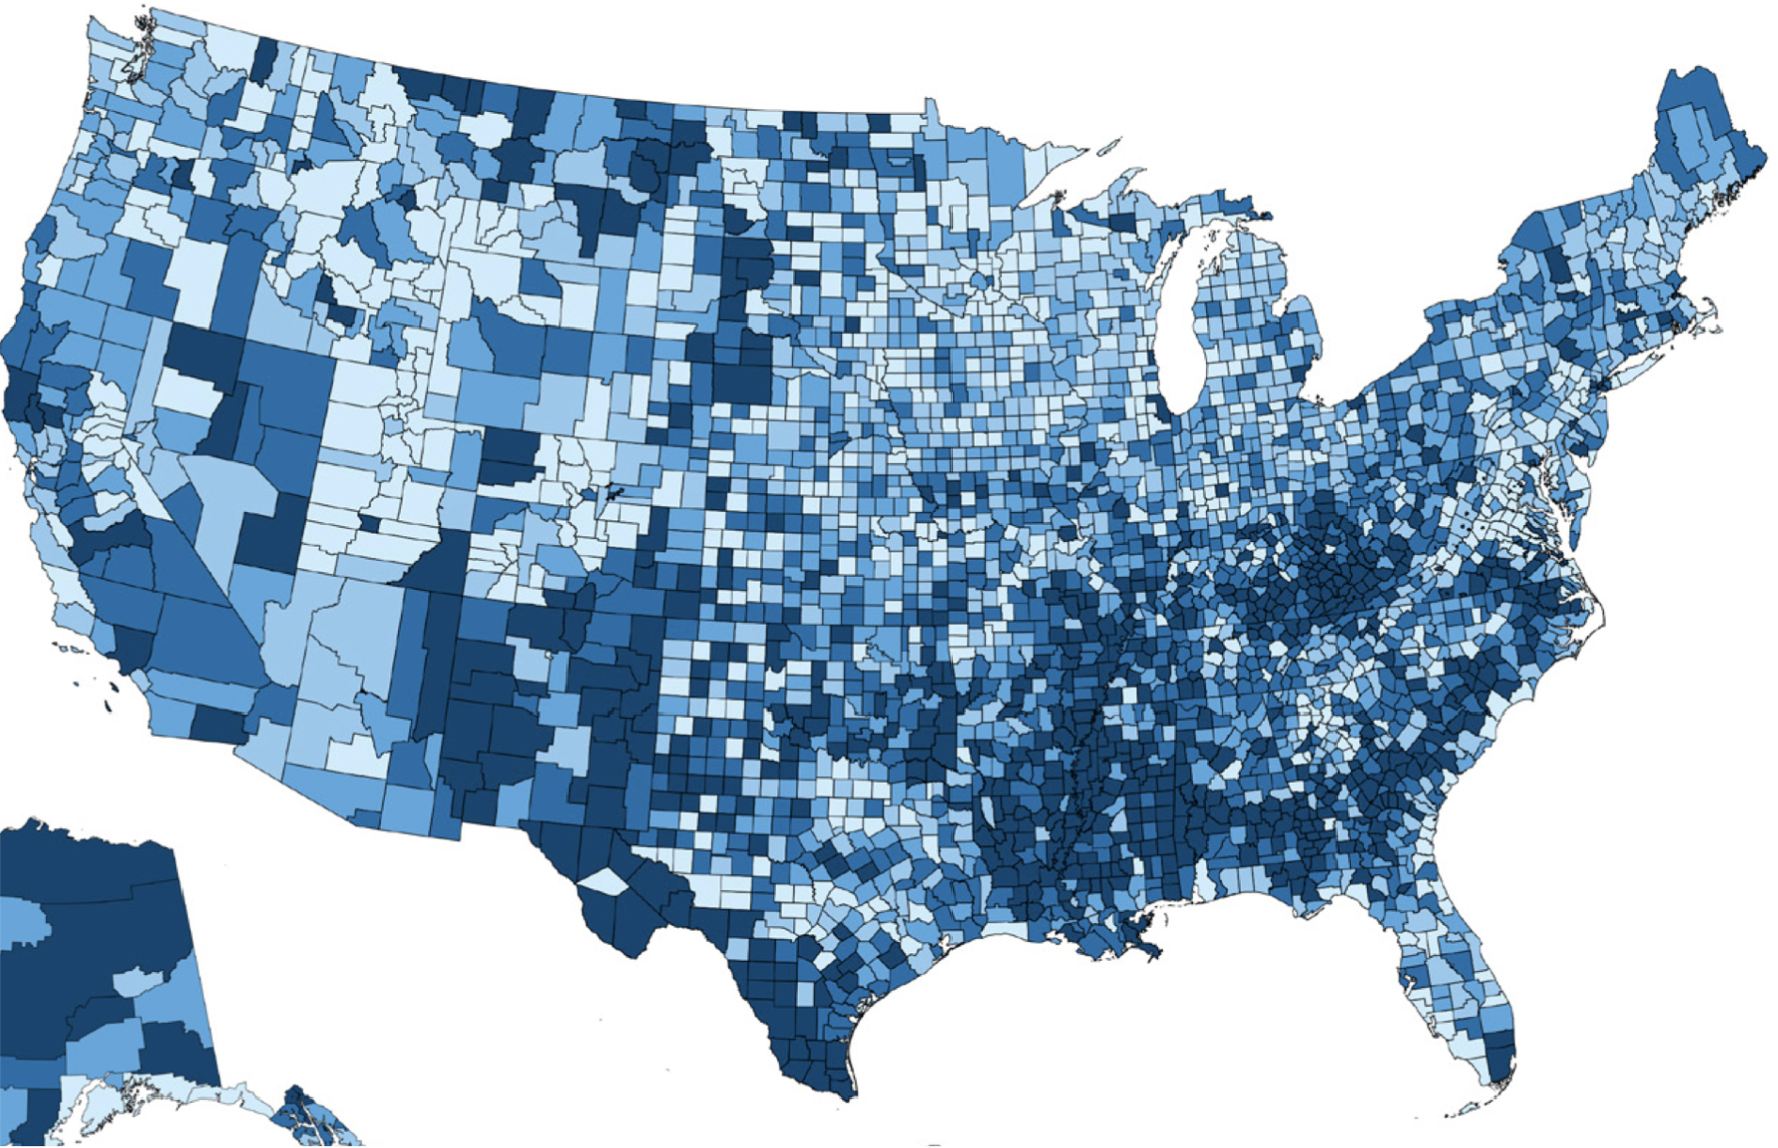
Social isolation and loneliness
Social isolation objectively measures the size and strength of one’s network.
Loneliness is the subjective shortcoming between the desired and experienced quantity and quality of relationships
Both are independent risk factors for:
Poor self-rated health and wellbeing
Cardiovascular disease
Dementia
All-cause mortality
COVID-19 lockdown: a shock in social isolation
How did older adults experience the Covid-19 pandemic?
(Lim et al 2020; Lu et al 2020; Office of National Statistics 2021)

Slide 3
Social isolation and loneliness
Heterogeneous taste for social connection means SSI does equal loneliness
depression, disease
Social Isolation
loneliness
COVID may have increased isolation exogenously breaking the simultaneity
We’re just looking at social isolation (variously measured) and loneliness

Slide 4
Data & Methods
USA National Health & Aging Trends Survey (NHATS)
Representative of Medicare beneficiaries aged 70y+ residing in the US in 2020
n= ~3,000 age
Longitudinal follow-up
Covid-19 module via mail in 2020
Able to respond
ANALYSIS:
COVID-associated loneliness: Linear probability model
Loneliness: Multinomial logit model
RACE/ETHNICITY
GENDER
EDUCATIONAL ATTAINMENT
AGE
Partnership
confidantes
LONELINESS
Social Isolation Index
4

Slide 5
Conventional indicators of social isolation

Slide 6
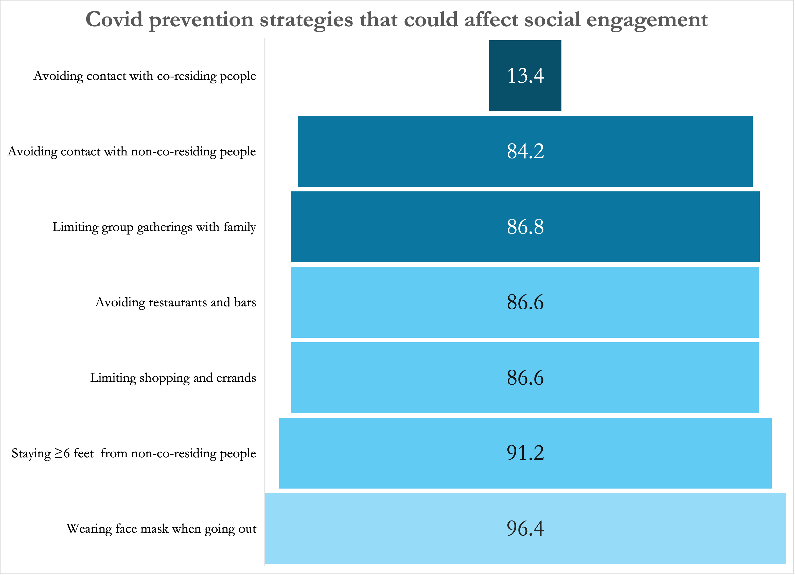
Older adults widely engaged in prevention strategies that could affect social engagement

Slide 7
Topologies of Loneliness
USA National Health & Aging Trends Survey (NHATS)
Supplemental Questionnaire sent in summer of 2020
Retrospective question on pre-COVID loneliness
 | Q49 “During the COVID-19 outbreak, in a typical week, how often have you felt lonely?” | Q50 “Is this more often, less often or about the same as a typical week before the COVID-19 outbreak started?”
Always lonely | every/most | same/less¹
COVID lonely | every/most | more often
Low-level, lonelier | some/rarely/never² | more often
Consistently some lonely | some | same
Less lonely | some/rarely/never | less
Never lonely | rarely/never | same
7

Slide 8
1 in 5 older adults felt lonelier during the pandemic

Slide 9
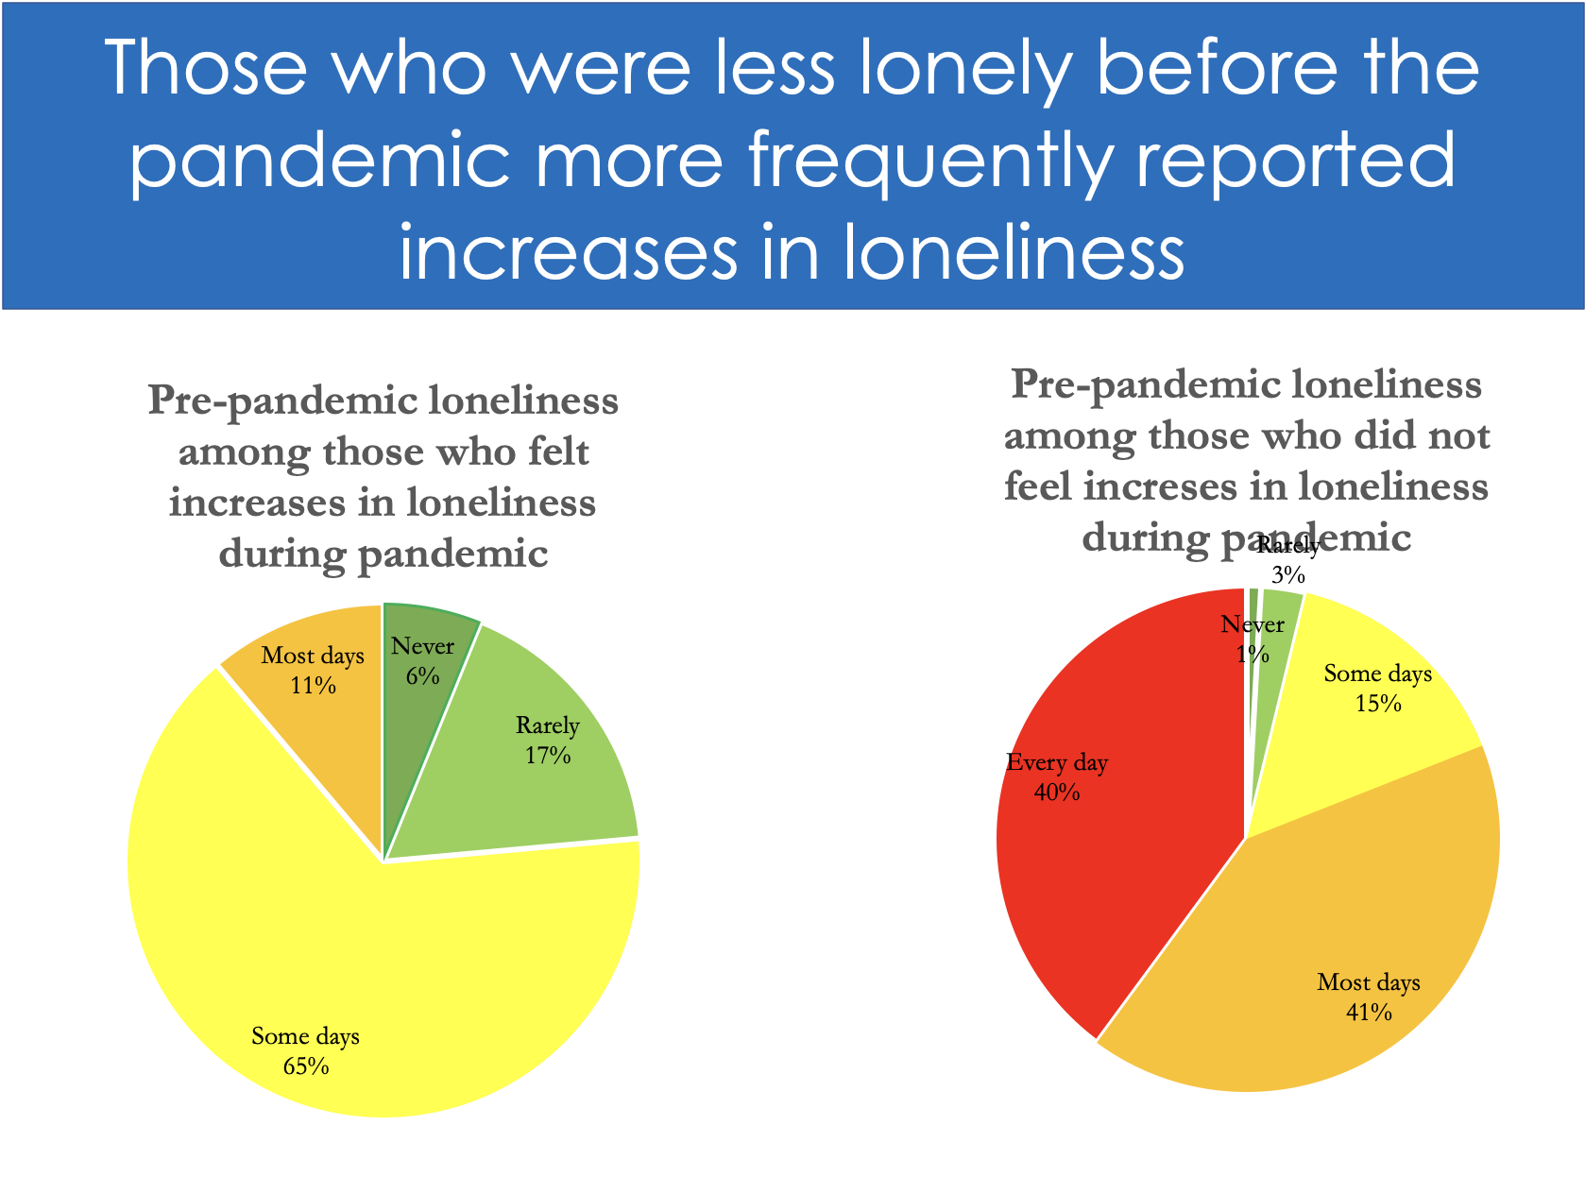

Slide 10
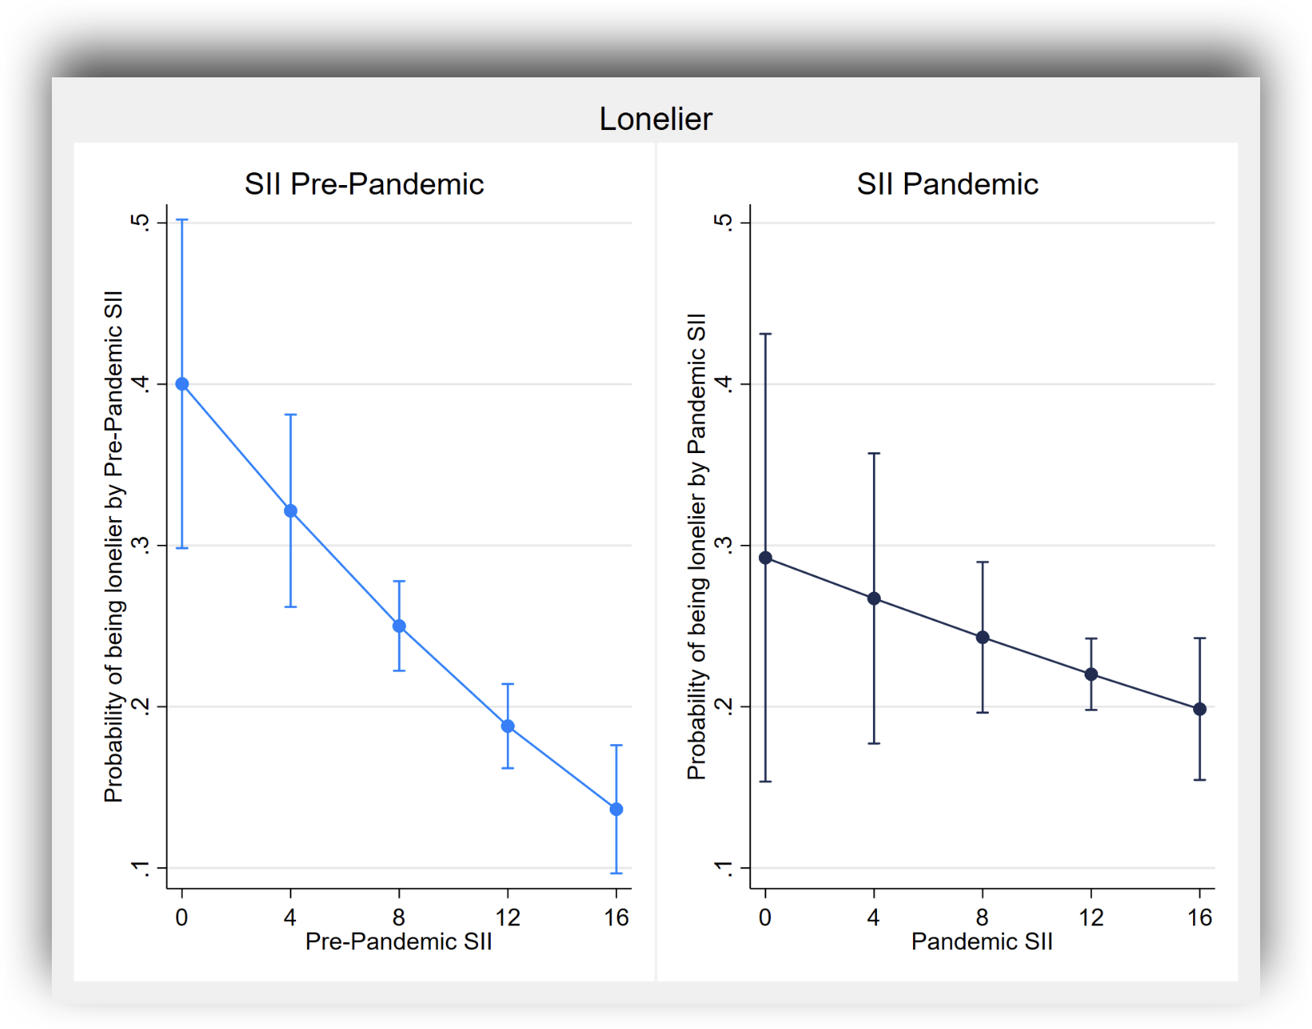
People that were already socially isolated before COVID were less likely to get lonelier
If already isolated, COVID may not have had much effect
Contemporaneous COVID SSI less predictive of getting lonelier
However, there’s not much variation in SSI between waves
More likely sorting on ISS and taste for companionship
Controlling for race/ethnicity, gender, age, education, partnership status, number of confidantes

Slide 11
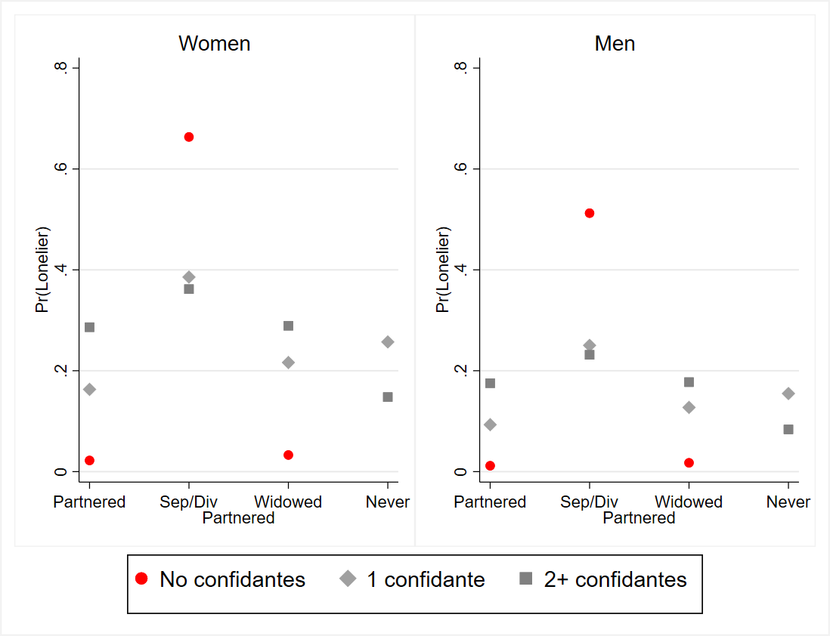
Confidantes and Loneliness
Controlling for race/ethnicity, age, education, social isolation index

Slide 12
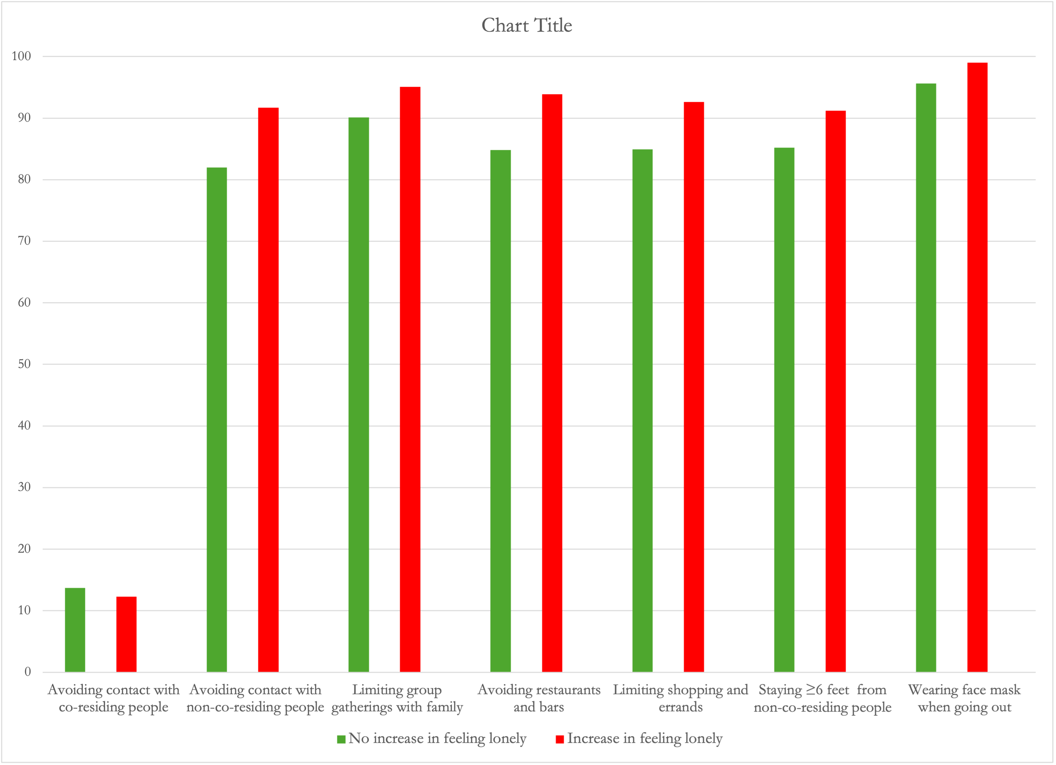
Did COVID preventive strategies play a role in feeling loneliness?
Older adults widely engaged in prevention strategies that could affect social engagement
COVID prevention strategies and increased loneliness

Slide 13
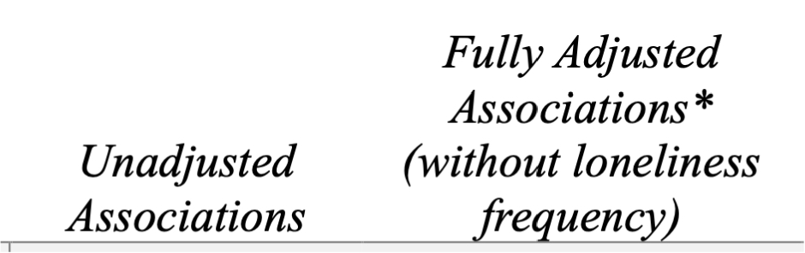
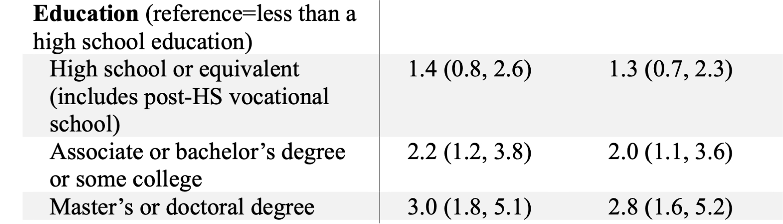
Social Distancing and Loneliness: baseline
Controlling for race/ethnicity, age, education, social isolation index

Slide 14
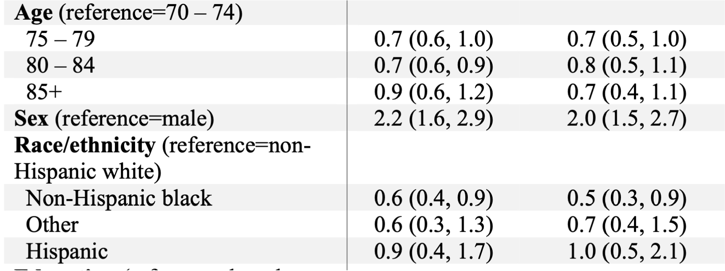
Social Distancing and Loneliness: baseline
Controlling for race/ethnicity, age, education, social isolation index

Slide 15
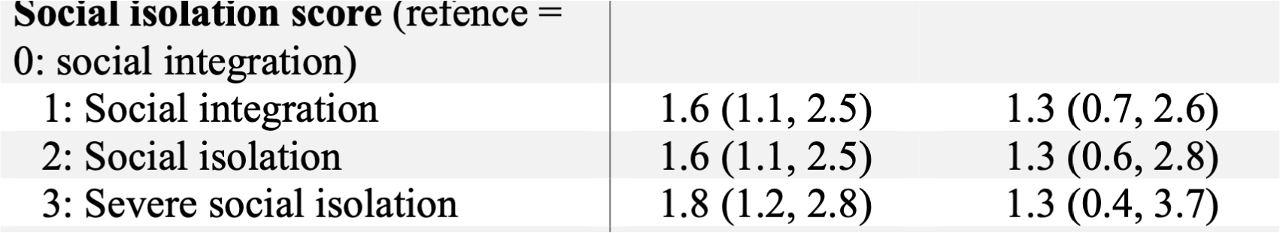
Conventional Social Isolation Measures and Loneliness
Controlling for race/ethnicity, age, education, social isolation index

Slide 16
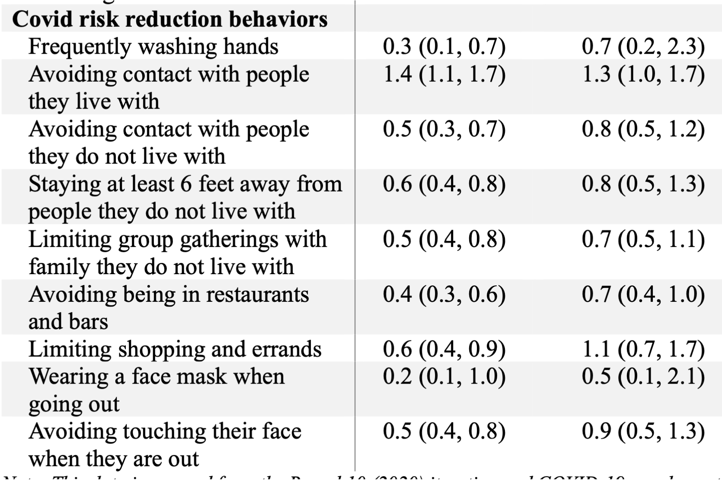
Social Distancing and Loneliness
Controlling for race/ethnicity, age, education, social isolation index

Slide 17
Findings:
Social isolation is only weakly associated with loneliness
Those separated or divorced and with few confidantes were most vulnerable to loneliness
Most of those who reported loneliness during the pandemic felt lonely before the pandemic
Those who were sometimes lonely before the pandemic more often became lonelier
Social Distancing Measures did not, statistically increase loneliness

Slide 18
ccunnin75@gmail.com
Supported in part by:
A Collaborative Research Grant from the University of St Andrews Global Institute & Emory University’s Halle Institute for Global Research
The ESRC funded Connecting Generations Centre

Slide 19

Definitions
Social isolation: “objective”; quantitative indicator of one’s social network; sometimes quality included, i.e., lack of “supportive” relationships
Loneliness: “subjective”; discrepancy between the quality and quantity of existing relationships and a person's desires or standards
Key point: Social isolation and loneliness do not always coexist.
(Landeiro et al. 2017; Lim et al 2020; Machielse and Duyndam 2020; Perlman & Peplau, 1981)
Notes:
Highlighting this bc they’re often conflated in the literature and one of the goals of my research project is to work to disentangle them.

Slide 20
Defining Social Isolation & Loneliness
Social Isolation Index*
Loneliness
Sociability:
Household composition (alone=1)
Works for pay
Cares for someone else
Goes out to socialize
Socializes with friends and/or family
Social cohesion
Church membership
Participates in religious activities
Community Organizations
Volunteers
Member of club, organization, society
Self-reports how often felt lonely before 1st COVID lockdown
Every day
Most days
Some days
Rarely
Never
COVID Loneliness
Self-reports how often felt lonely during COVID compared to before 2020
Less
About the same
More
*Adapted from the Berkman-Syme Index (1979)

Slide 21

Data & Methods
USA National Health & Aging Trends Survey (2011-2023)
Nationally-representative of 70+ population, population-based panel survey
Survey covers domains such as education, health and social behaviors, social cohesion, and health
Round 10: Administered in 2020 via telephone
Covid-19 module: Administered in June – October 2020 via mailed paper survey
Analytical sample n ≈ 3,000

Slide 22

Hypotheses based on background (Q&A!!!)
Hypothesis 1: blahblah.
1a)
1b)
Hypothesis 2:
blahblah.
Notes:
Race/eth, early wealth, part stat, labor stat, comorbidity, loneliness, drink, smoke

Slide 23
Table 6.1. Descriptive characteristics of the sample over the study period 1996-2018
 | Not Lonely | Lonely | Total
 | Mean/% | Mean/% | Mean/%
Loneliness status | 83.2 | 16.8 | 100
Cognitive function | 15.7 | 13.6 | 15.3
Age | 66.7 | 68.2 | 67.0
Female | 80.6 | 19.4 | 58.2
Male | 86.8 | 13.2 | 58.2
Covariates |  |  | n person-waves
Race/Ethnicity
White | 85.3 | 14.7 | 120,379
Black | 79.2 | 20.8 | 26,283
Latinx | 75.0 | 25.0 | 18,100
Other | 81.5 | 18.5 | 4,861
Education
Less than high school | 73.3 | 26.7 | 33,510
HS/GED/some college | 83.5 | 16.5 | 88,484
Associate or above | 89.4 | 10.6 | 47,629
Total | 141,076 | 28,547 | 169,623

Slide 24
Summary statistics
 | Not Lonely | Lonely | Total
 | Mean/% | Mean/% | Mean/%
Labor Force Status
Full time work | 89.6 | 10.4 | 43,775
Part time work | 87.9 | 12.1 | 22,807
Retired | 80.9 | 19.1 | 83,236
Unemployed | 75.5 | 24.5 | 3,384
Disabled | 59.4 | 40.6 | 4,231
Not in labour force | 77.2 | 22.8 | 12,190
Partnership Status
Partnered | 90.5 | 9.5 | 109,822
Separated/divorced | 71.9 | 28.1 | 22,544
Widowed | 66.7 | 33.3 | 30,542
Never married | 75.6 | 24.4 | 6,715

Slide 25
Summary statistics
 | Not Lonely | Lonely | Total
 | Mean/% | Mean/% | Mean/%
Depressive symptoms
0 | 96.1 | 3.9 | 78,806
1 | 89.2 | 10.8 | 38,817
2-4 | 69.9 | 30.1 | 38,019
5-7 | 29.6 | 70.4 | 13,981
Functional limitations
No limitation | 86.1 | 13.9 | 147,392
Limitation(s) | 63.5 | 36.5 | 22,231
Co-morbidity
None | 86.7 | 13.3 | 60,244
One | 83.8 | 16.2 | 60,665
Two | 80.0 | 20.0 | 34,602
Three | 74.1 | 25.9 | 12,058
Four | 68.4 | 31.6 | 2,054

